Slide 1

CSE7101- Capstone Project
Review-1
USE OF DIGITAL TECHNOLOGY TO CALCULATE FOOTPRINTS FOR DIFFERENT DAILY USE ITEMS
Batch Number: COM_15
ROLL NUMBER | STUDENTS NAME
20221COM0149 | SUSHMITHA N
20221COM0161 | LATHASHREE
20221COM0184 | RASHMI N
Under the Supervision of,
Mr.Mohamed Shakir
Assistant Professor
School of Computer Science and Engineering
Presidency University
Name of the Program: BTech
Name of the HoD: Dr.Pallavi
Name of the Program Project Coordinator: Benitha Christinal J
Name of the School Project Coordinators: Dr. Sampath A K , Dr. Geetha A

Slide 2
Content
Overview ( problems , objectives and approach)
Research papers(literature survey)
Objectives
Existing methods and drawbacks
Proposed methods and feasibility study
Architecture Diagram
Modules
Hardware and software
Timeline(gantt chart)
References

Slide 3
Overview
Problem : Freshwater resources are under extreme stress due to overuse, pollution, and climate change. A water footprint measures the amount of water consumed and polluted to produce goods and services, yet most citizens remain unaware of the hidden water costs of their daily use items (e.g., food, clothes, energy, electronics). This lack of awareness contributes to unsustainable consumption patterns, worsening the risk of droughts, water scarcity, and groundwater depletion.

Slide 4
Objectives
Develop a simple tool to raise awareness of water footprints in daily-use items.
Design a user-friendly app/website to estimate and visualize product water footprints.
Ensure inclusivity with local language support and easy interfaces.
Use AI, Big Data, and Blockchain for accurate, transparent, real-time calculations.
Build a reliable database to support policymakers, NGOs, and authorities in water conservation.

Slide 5
Approach
Gather and integrate water footprint datasets using Big Data for accuracy and scalability.
Apply AI/ML for product recognition and Blockchain for secure, transparent data storage.
Develop a mobile app/website with simple and user-friendly UI/UX.
Provide multi-language support (English + major Indian languages).
Offer personalized insights, comparisons, and tips to promote water-efficient choices.

Slide 6

Literature Survey
S. No. | Year & Author(s) | Key Components | Limitations
1 | 2022 – Li, Sun, et al. | Proposed Blockchain framework for transparent water governance and monitoring. | Focused on governance; not consumer-facing applications.
2 | 2023 – Urban Water Researchers | Explored blockchain applicability in urban water supply systems for transparency. | Limited to utility-level management; not item-level water footprints.
3 | 2011 – Cooper & Pafumi | Applied water footprint assessment to semiconductor industry (real industrial case study). | Industry-specific; not generalized to daily-use consumer products.
4 | 2022 – van der Ent & colleagues | Proposed virtual water tracking frameworks for trade and reporting. | Theoretical; lacks real-time app or AI integration.
5 | 2025 – RSC Researchers | Advanced methods to convert volumetric water use into scarcity-weighted impact scores. | Requires regional scarcity data; difficult for quick consumer apps.
6 | 2023 – Li, Ren, et al. | Quantified the hidden water footprint of AI/data centers; highlighted sustainability risks. | Focused on AI infrastructure; not consumer product footprints.
7 | 2017–2020 – UTwente Case Studies | Conducted product-level water footprint analyses (e.g., tea, margarine). | Narrow scope (few products); datasets not easily scalable.
8 | 2024 – Systematic Review Authors | Reviewed LCA methods including freshwater use; highlighted strengths and weaknesses. | Generic review; does not give ready-to-use tools for consumers.
9 | 2023 – Review Authors | Analyzed limitations of WF sustainability assessments; proposed improvements. | Review only; no concrete digital implementation framework.
10 | 2023 – Blockchain Traceability Researchers | Applied blockchain for supply chain traceability, improving product provenance. | Focused mainly on carbon/energy footprints, not directly on water.

Slide 7
Objectives
Awareness Creation
Data Integration
Use of Digital Technologies
Localization & Accessibility
Personalization & Insights
Sustainability Impact

Slide 8
Existing Methods and Drawbacks
Manual / Research-Based Assessments
Databases & Reports
Awareness Campaigns by NGOs/Governments

Slide 9
Proposed Method and Feasibility Study
Proposed Method:
The project proposes to develop a digital platform (mobile app + website) that calculates and visualizes the water footprint of daily-use items in an accessible, transparent, and user-friendly manner.
Key Components:
Data Collection & Integration
AI/ML for Product Recognition & Prediction
App/Website Development

Slide 10
Proposed Method and Feasibility Study
Feasibility Study:
Technological Feasibility
Cost Feasibility
Resource Feasibility

Slide 11
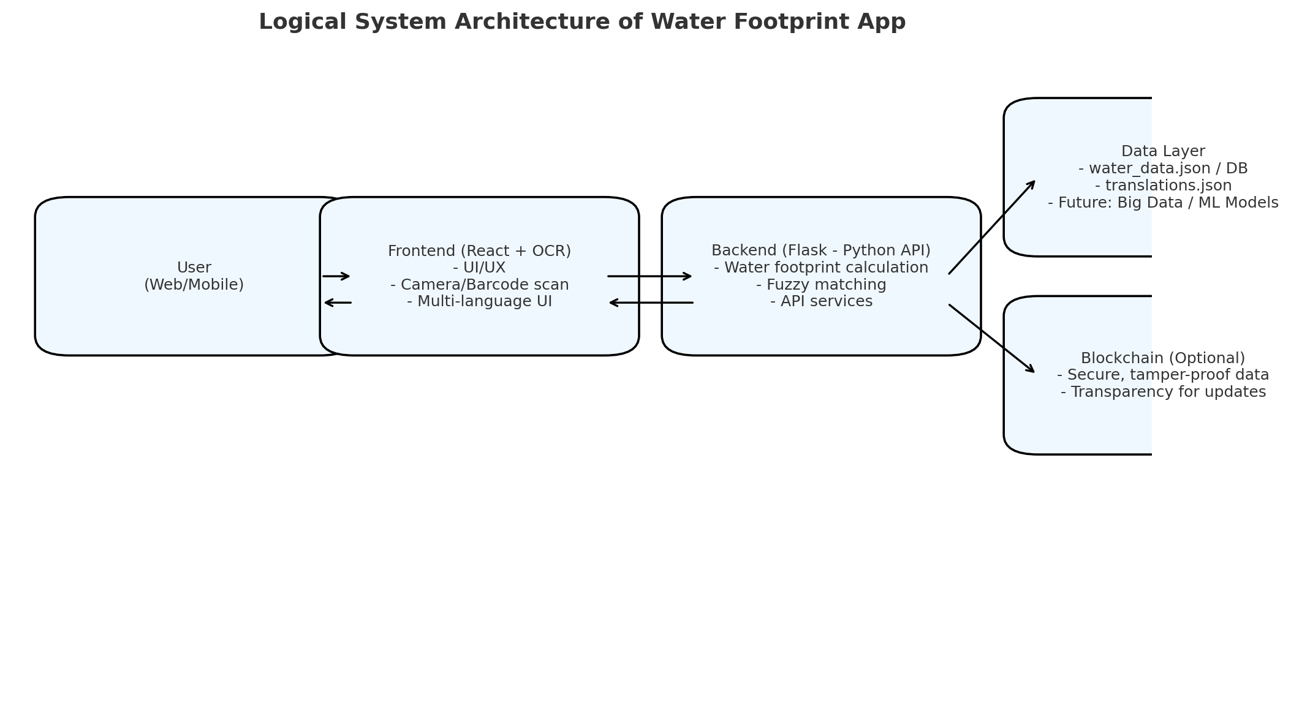
Architecture Diagram

Slide 12
Modules
User Interface Module
User Profile Module
Product Input Module
Calculation Engine
Database Module
Visualization Module
Recommendation Module
Localization Module

Slide 13
Hardware and Software Details
Hardware:
Development: i5 processor, 8 GB RAM, 20 GB storage, Windows/Linux/Mac.
Deployment: 2 vCPUs, 4–8 GB RAM, 50 GB SSD, AWS/Heroku/Cloud hosting.
Optional: NVIDIA GPU for AI/ML module.
Software:
Backend: Python 3.8+, Flask, flask-cors, python-dotenv, JSON dataset.
Frontend: React 18.2, Tesseract.js (OCR), Axios, Parcel bundler.
Database: JSON (current), expandable to SQLite/PostgreSQL/MongoDB.
Tools: npm/pip, VS Code, Docker (optional), Cloud (AWS/GCP).

Slide 14
Timeline(Gantt Chart)
Phase 1: Requirement Analysis & Feasibility Study (Weeks 1–2)
Phase 2: System Design & Architecture (Weeks 3–4)
Phase 3: Prototype Development & Core Functionality (Weeks 5–8)
Phase 4:Advanced Features & Multi-language Support (Weeks 9–12)
Phase 5: Testing, Feedback & Launch Preparation (Weeks 13–16)

Slide 15
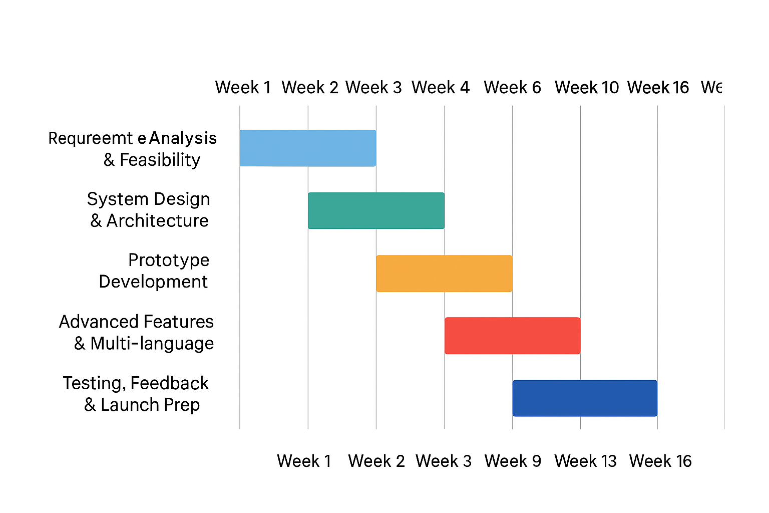
Timeline(Gantt Chart)

Slide 16
GitHub Link
https://github.com/Rashmi83-colab

Slide 17
References (IEEE Paper format)
H. Gerbens-Leenes, A. Y. Hoekstra, and T. Van der Meer, “The water footprint of energy from biomass: A quantitative assessment and consequences of an increasing share of bio-energy in energy supply,” Ecological Economics, vol. 68, no. 4, pp. 1052–1060, Feb. 2009.
A. S. Shrestha, P. Shukla, and R. K. Gupta, “Blockchain-based solutions for sustainable water management,” IEEE Access, vol. 10, pp. 12548–12560, Feb. 2022.
L. Zhang, K. Li, and H. Wang, “Big data-driven approaches for environmental sustainability,” IEEE Transactions on Big Data, vol. 7, no. 3, pp. 456–468, Jun. 2021

Slide 18


